Slide 1
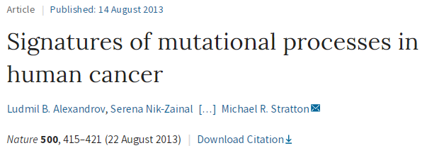
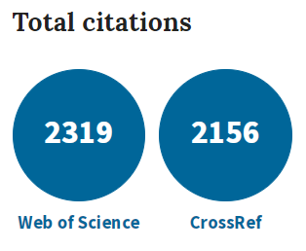

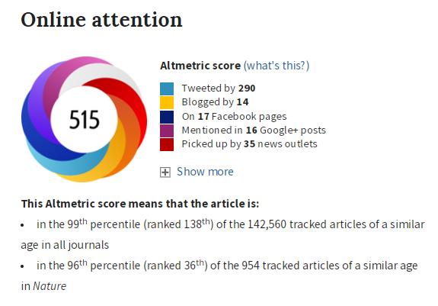

Slide 2


Authors / Funding
Affiliations
Cancer Genome Project, Wellcome Trust Sanger Institute, Wellcome Trust Genome Campus, Hinxton, Cambridgeshire, UK.
Department of Medical Genetics, Addenbrooke’s Hospital NHS Trust, Hills Road, Cambridge, UK.
Molecular Oncology, Michael Smith Genome Sciences Centre, BC Cancer Agency, Vancouver, Canada
Department of Pathology, University of British Columbia,, British Columbia, Vancouver, Canada
…
Sanger Institute: “We use genome sequences to advance understanding of the biology of humans and pathogens to improve human health”
Wellcome Trust: “We’re a global charitable foundation, both politically and financially independent.” “We have a £23.2bn investment portfolio, which funds all the work we do. “
Consortia
Australian Pancreatic Cancer Genome Initiative
ICGC Breast Cancer Consortium
ICGC MMML-Seq Consortium
ICGC PedBrain
"No cancer therapy is developed today without the genomic knowledge that ICGC provided to the world.“ The ICGC, established in 2007, aimed to define the genomes of 25,000 primary untreated cancers (the 25K Initiative).

Slide 3
Nature Editorial Summary
This study analyses almost 5 million mutations from more than 7,000 cancers and demonstrates more than 20 distinct cancer-associated mutational signatures.
Some of these signatures are present in many cancers, notably a signature attributed to the APOBEC family of cytidine deaminases, whereas others are specific to individual tumor types.
Some signatures are associated with age, known mutagenic exposures or defects in DNA maintenance, but many are of cryptic origin.
These findings have potential implications for the understanding of cancer aetiology, prevention and therapy.
Notes:
Cancer mutations are a mixed bag.
Despite the fact that all cancers are thought to result from somatic mutation — mutations in any cell in the body excluding the germ cells — relatively little is known about the processes of mutation involved.

Slide 4
Signatures of mutational processes
in human cancer
Mutations occurring through RANDOM fashion
Ultimately leading to a better cancer cell fitness
Advantages compared to surrounding healthy cells
Drivers and
2) Passengers mutations (less obvious role)
Inactivation of Tumor Suppressors (e.g. p53)
Gain of Function of Oncogenes
(e.g. epidermal growth factor receptor EGFR)
In comparison to
Regulation of Genes’ Expression that does NOT affect DNA
Cancer Regulation via Epigenetics
Notes:
Mutations to promote survival of Cancer Cells.
Better chances for Cancer Cells to survive, vs. normal cells around them.
Drivers Mutations are the obvious ones.
Another way to promote Cancer Cell survival is through Epigenetics “on top of” genes:
Not altering Genetic Information, but regulate the Genes’ expression via
DNA methylation and Histones post-translational modifications (PTMs).

Slide 5
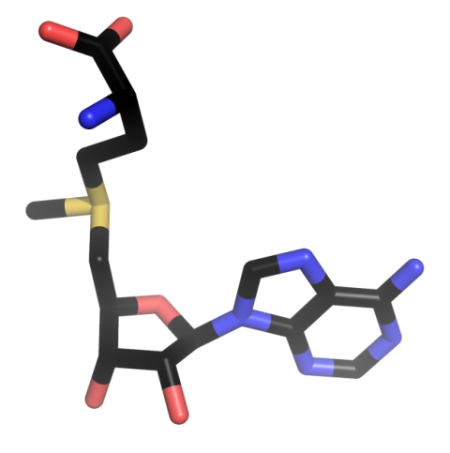
Regulation of Gene Expression
Epigenetics 1: The CpG Methylation
Reactions catalyzed by DNA methyltransferases
DNMT1, DNMT3
Where: at CpG Motifs, near transcription-start sites
Epigenetics: DNA information is NOT changed
Yet, DNA methylation REPRESSES genes’ transcription
SAM cofactor
Lyko F Nat Rev Genet. 2018 19(2):81-92
Notes:
The Epigenetics via DNA methylation.
Recognition of deoxyCytidine-Phospho-deoxyGuanosine
Methylation using Universal Cofactor S-adenosyl-L-methionine
There is a balance between methylated and unmethylated CpG: methyltransferase and demethylase activities

Slide 6
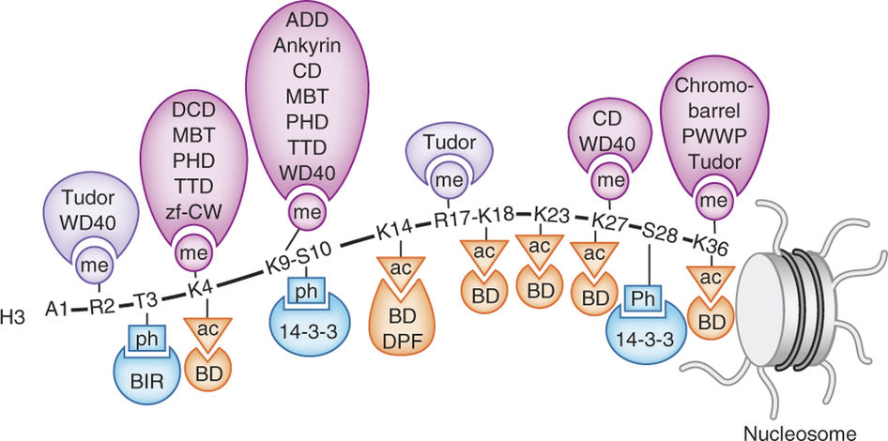
Regulation of Gene Expression:
Epigenetics 2: The Histone Code
Histones & their post-translational modifications
Tuned mechanism: Chromatin Structure & Dynamics
Docking Sites: Effectors & Readers (μM affinities)
Recruiting & Stabilization at specific genomic sites
Fundamental Processes
Gene Transcription
DNA Repair
> 10⁹
Possibilities
 | Histone H3
 | K4 | K9
me1 | Activation
me2 |  | Repression
me3
 | Gene Expression
Musselman, CA et al. Nat Struct Mol Biol 2012, 19, 1218-27
Allis CD et al. Genes Dev. 1993 7(4), 592; EMBO J. 1996 15(10), 2508; Mol Cell Biol. 1996 16(8), 4349; Nature 1996 383(6597), 269.
Notes:
The Epigenetics via Histones post-translational modifications (PTMs).
Histone Code Hypothesis.
Enzymes can write or erase PTMs
Writer: Lysine Methyltransferase (Lysine K9 being methylated)
Eraser: Sirtuin Deacethylase (removes acetyl group from Lysine K16)
Readers: Transcription factors and other proteins recruited onto Chromatin for Gene Transcription

Slide 7
Mutations and Signatures in Cancer
Personalized Medicine and Computational Power
Gigantic Sequencing data-sets from numerous Biopsies
~7 x 10³ tumors from 30 different classes (breast, lung, prostate…)
Identification of ~5 x 10⁶ substitutions
compared to Normal Healthy surrounding tissues
High Variability within different Cancer Classes
Correlation, Signatures, Understand
→ Better CONTROL of Cancer
Notes:
Progress in Medicine allowing for sequencing and analysis of tumors from many patients.
Big libraries of sequencing data, with their matching normal templates.
Our understanding of mutation mechanism may allow us to better address Cancer

Slide 8
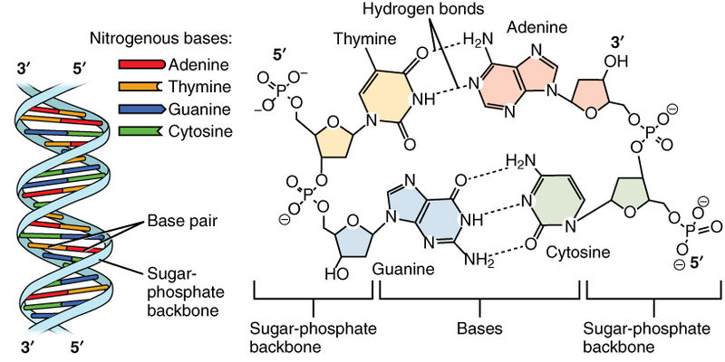
Setting up an Alphabet to
Read and Understand Mutations
A base-6 SIMPLE Alphabet
C→A, C→G, C→T
T→A, T→G, T→C
TOO SIMPLE (low correlation)
pediaa.com
Notes:
There are six possible mutations. Very simple/basis model.
Thus add information from the nearest neighbor of the mutated base (at 5’ and 3’ positions)

Slide 9
Setting up an Alphabet to
Read and Understand Mutations
Add INFO from surrounding BASES (5’ and 3’)
5’Xp “C” pY3’
More elaborate with 4*6*4 = 96 combinations
Each signature has a very unique Probability Density Function
Finger Print
Notes:
A more complex, yet still easy to handle alphabet with 96 combinations.
Each Signature has a unique finger print.

Slide 10
Setting up an Alphabet to
Read and Understand Mutations
Some mutations have no obvious association
For some others:
Age, Smoking, UV-exposure
DNA mismatch repair deficiency,
BRCA mutations, APOBEC expression

Slide 11
The APOBEC Association
C→T with 5’-T and 3’-A/T
Notes:
The signature 2 is characterized by highly elevated C>T mutation
This signature occurs in 16 types of cancers (out of the 30 studied) and has a prevalence of ~15%.
It is associated with APOBEC

Slide 12
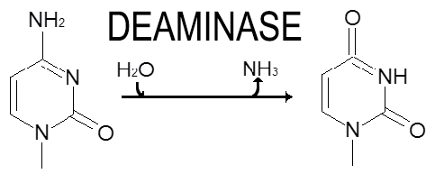
What is APOBEC?
Apolipo-protein B mRNA editing catalytic polypeptide-like
Key molecular DRIVER inducing mutations in Cancers
APOBEC-3B is an Enzyme:
DNA cytosine deaminase
Overexpressed in Cancers
→ Unexpected clusters of mutations
Kataegis
Cytidine Uridine
Notes:
This Kataegis can be explained through a rational based on the enzymatic activity of APOBEC-3B enzyme.
The Cytosine deaminase preferentially recognizes substrates with a 5’T and 3’A/T.
So that the TT-C-A “DNA-sequence” is deaminated more efficiently than TT-C

Slide 13
https://www.youtube.com/watch?v=yQ3HDiM4-2s

Slide 14
The APOBEC Association
C→T with 5’-T and 3’-A/T
Not so RANDOM region of
C→ T base substitutions
Localized Hypermutations
Kataegis
Rainfall plot of base substitutions for PD4107a Breast Cancer line. On x-axis mutation number from ch-1 to ch-X and on y-axis inter-mutation distance (base pair)
Nik-Zainal S. et al. “Mutational processes molding the genomes of 21 breast cancers” Cell. 2012 149(5):979-93
Notes:
The pattern of C>T mutation within Signature 2 is very well define with a preference for
5’ position being a T base
3’ position being a A/T base
Within Breast Cancer, a Rainfall plot allows for easy visualization of unique and localized clusters of such mutations: Kataegis

Slide 15
Remarks and Conclusion
New Algorithms and Computational Framework
Identification of novel mutation sites: Kataegis (not so random)
Little explanation on the actual computational
see thesis:
ftp://ftp.sanger.ac.uk/pub/resources/theses/la2/alexandrov_ludmil_thesis.pdf
Some have a Probable Association
Yet, majority of these signatures have to be explained
Perform mRNA-seq analysis (transcriptomic) on these tumors
Data available (Oncomine Data Base oncomine.org)
Identify Association
Provide a Novel Approach to better understand Cancer
Driving forces → Target new Pathways (metabolism, signaling)

Slide 16
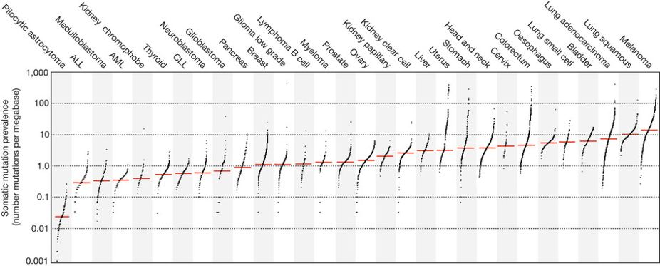
Figure 1 : The prevalence of somatic mutations across human cancer types.
Every dot represents a sample whereas the red horizontal lines are the median numbers of mutations in the respective cancer types. The vertical axis (log scaled) shows the number of mutations per megabase whereas the different cancer types are ordered on the horizontal axis based on their median numbers of somatic mutations. ALL, acute lymphoblastic leukaemia; AML, acute myeloid leukaemia; CLL, chronic lymphocytic leukaemia.

Slide 17
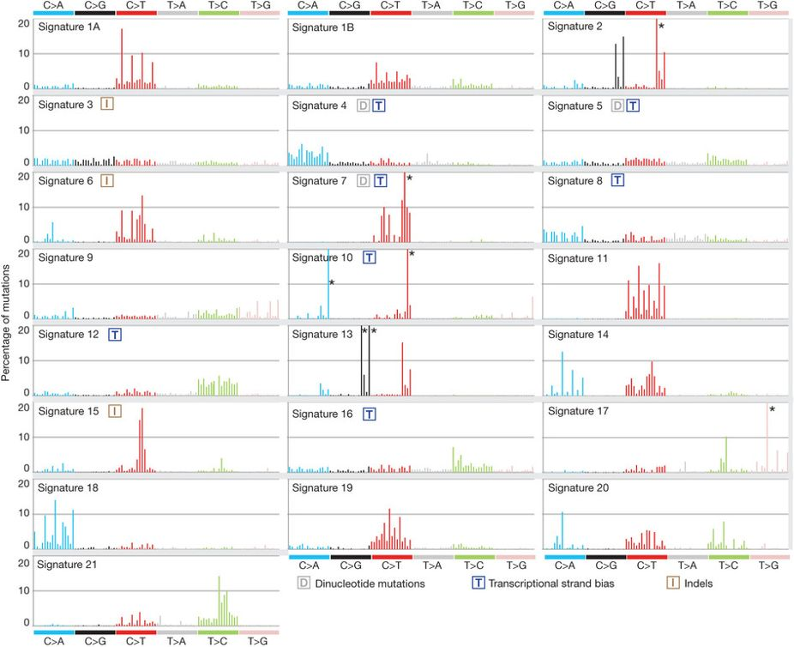
Figure 2 : Validated mutational signatures found in human cancer.
Each signature is displayed according to the 96 substitution classification defined by the substitution class and sequence context immediately 3′ and 5′ to the mutated base. The probability bars for the six types of substitutions are displayed in different colors. The mutation types are on the horizontal axes, whereas vertical axes depict the percentage of mutations attributed to a specific mutation type. All mutational signatures are displayed on the basis of the trinucleotide frequency of the human genome. Asterisk indicates mutation type exceeding 20%.
Notes:
Each signature is displayed according to the 96 substitution classification defined by the substitution class and sequence context immediately 3′ and 5′ to the mutated base. The probability bars for the six types of substitutions are displayed in different colours. The mutation types are on the horizontal axes, whereas vertical axes depict the percentage of mutations attributed to a specific mutation type. All mutational signatures are displayed on the basis of the trinucleotide frequency of the human genome. A higher resolution of each panel is found respectively in Supplementary Figs 2–23. Asterisk indicates mutation type exceeding 20%.

Slide 18
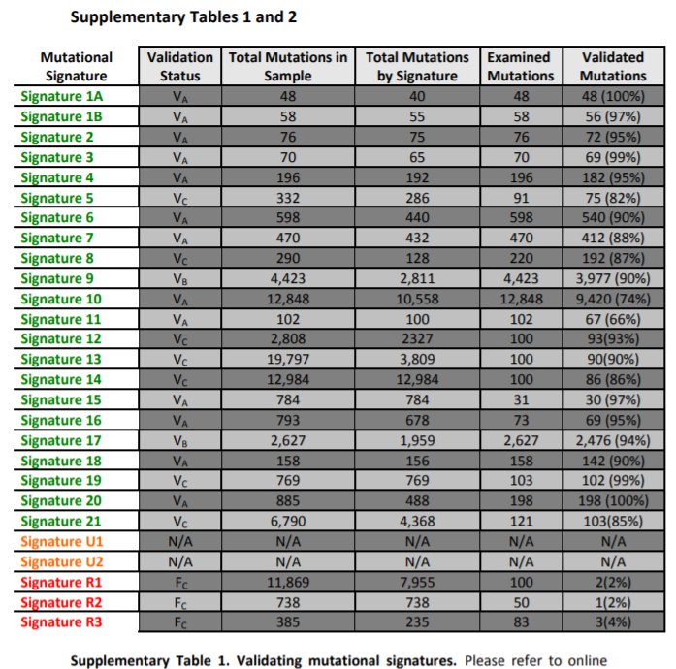

Slide 19
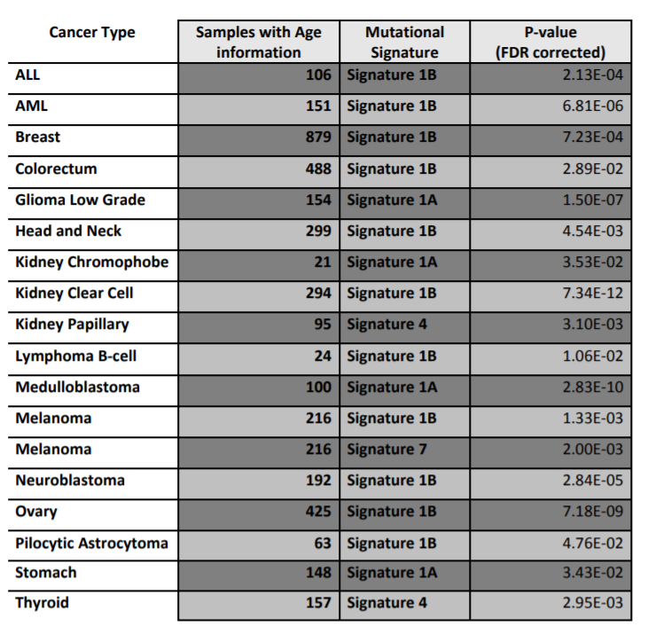

Slide 20
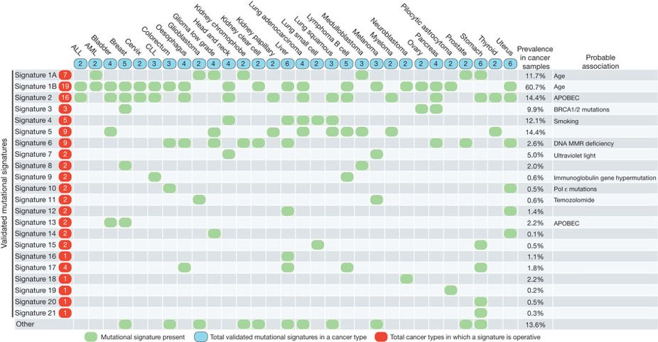
Figure 3 : The presence of mutational signatures across human cancer types.
Cancer types are ordered alphabetically as columns whereas mutational signatures are displayed as rows. ‘Other’ indicates mutational signatures for which we were not able to perform validation or for which validation failed. Prevalence in cancer samples indicates the percentage of samples from our data set of 7,042 cancers in which the signature contributed significant number of somatic mutations. For most signatures, significant number of mutations in a sample is defined as more than 100 substitutions or more than 25% of all mutations in that sample. MMR, mismatch repair.
Notes:
Cancer types are ordered alphabetically as columns whereas mutational signatures are displayed as rows. ‘Other’ indicates mutational signatures for which we were not able to perform validation or for which validation failed (Supplementary Figs 24–28). Prevalence in cancer samples indicates the percentage of samples from our data set of 7,042 cancers in which the signature contributed significant number of somatic mutations. For most signatures, significant number of mutations in a sample is defined as more than 100 substitutions or more than 25% of all mutations in that sample. MMR, mismatch repair.

Slide 21
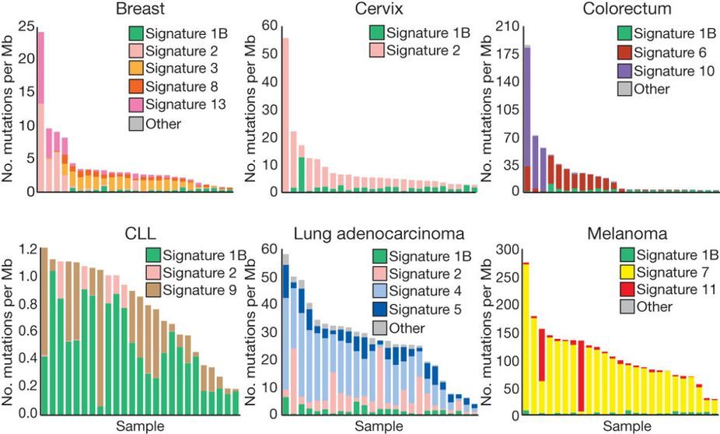
Figure 4 : The contributions of mutational signatures to individual cancers of selected cancer types.
Each bar represents a typical selected sample from the respective cancer type and the vertical axis denotes the number of mutations per megabase.
Notes:
Each bar
A megabase is a term used in genetics to measure the length (number of base pairs) of a genome segment. Megabases measure the physical distance of a genome region whereas a centiMorgan is used to measure the genetic distance.
1 Mb = 1,000,000 bases = 1 Megabase
represents a typical selected sample from the respective cancer type and the vertical axis denotes the number of mutations per megabase. Contributions across all cancer samples could be found in Supplementary Figs 29–58.

Slide 22
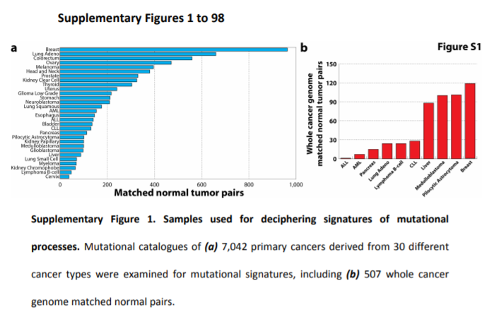

Slide 23
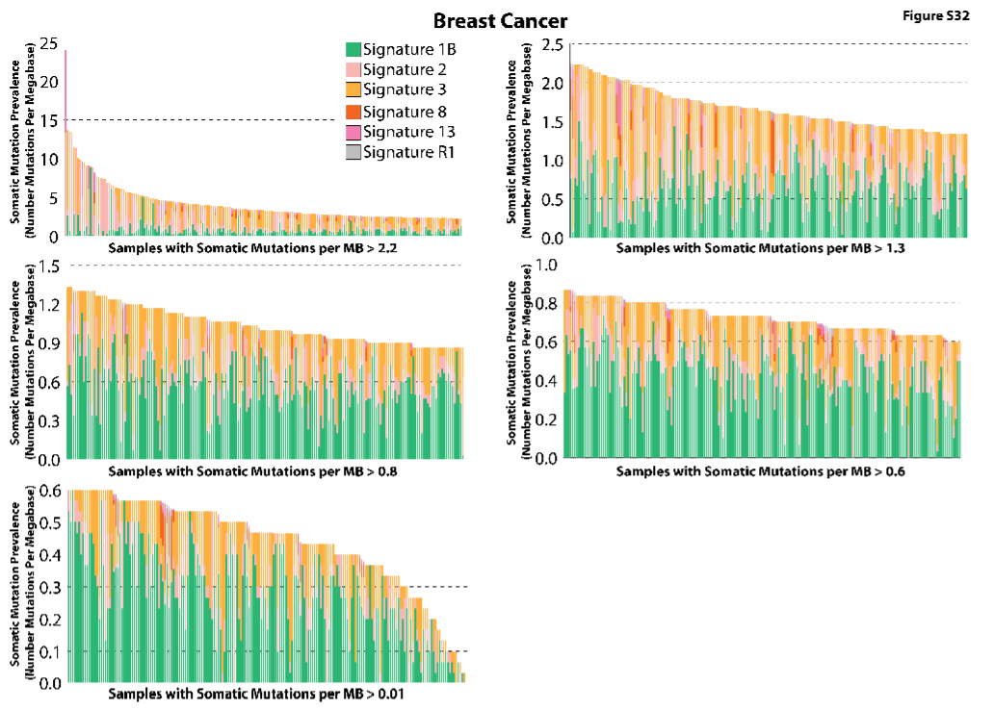
Supplementary Figure 32. Contributions of the signatures of mutational processes operative in breast cancer. Samples are displayed on the horizontal axis, sorted in descending order based on the numbers of somatic mutations per megabase found in each sample.
Notes:
Supplementary Figure 32. Contributions of the signatures of mutational processes operative in breast cancer. Samples are displayed on the horizontal axis, sorted in descending order based on the numbers of somatic mutations per megabase found in each sample.

Slide 24
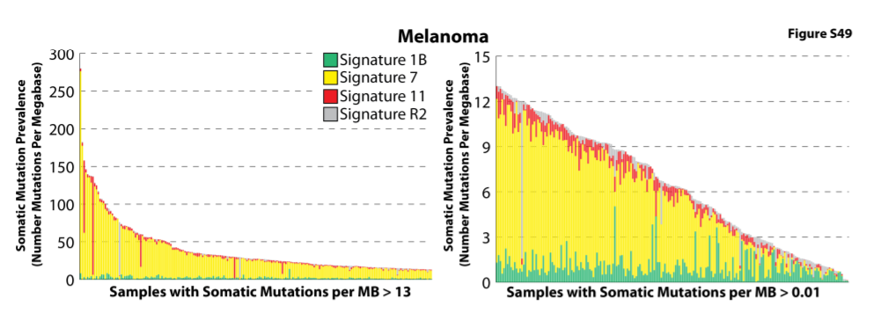

Slide 25
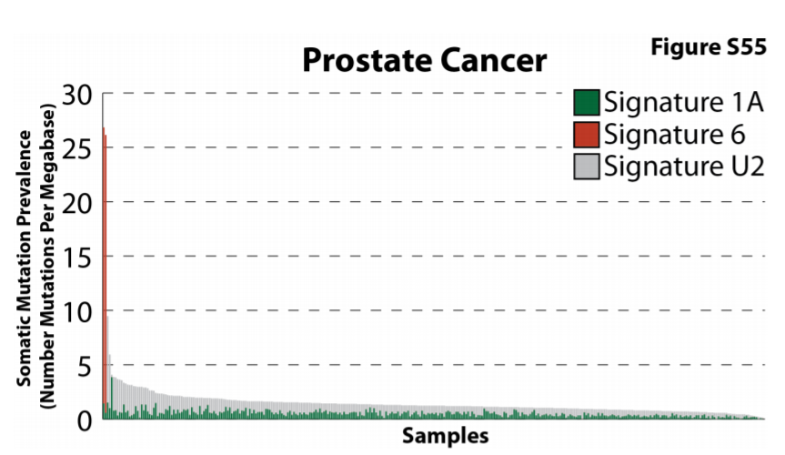

Slide 26
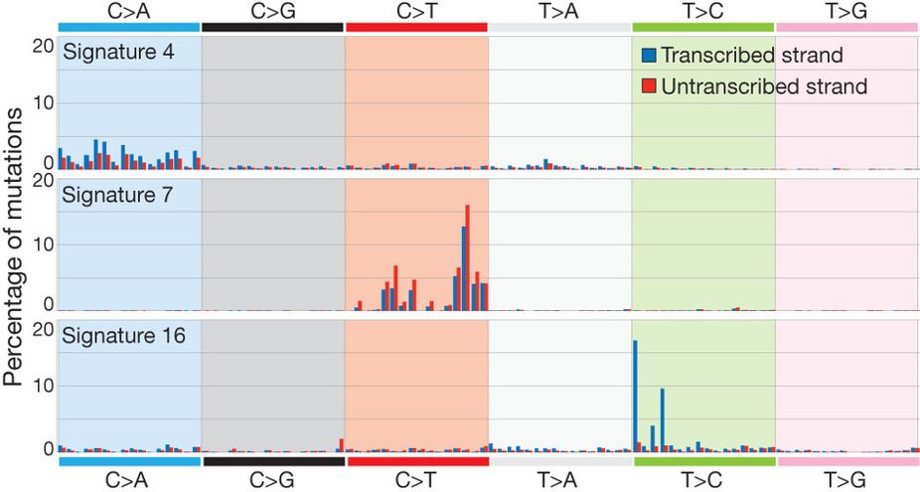
Figure 5 : Selected mutational signatures with strong transcriptional strand bias.
Mutations are shown according to the 192 mutation classification incorporating the substitution type, the sequence context immediately 5′ and 3′ to the mutated base and whether the mutated pyrimidine is on the transcribed or untranscribed strand. The mutation types are displayed on the horizontal axis, whereas the vertical axis depicts the percentage of mutations attributed to a specific mutation type.
Notes:
Mutations are shown according to the 192 mutation classification incorporating the substitution type, the sequence context immediately 5′ and 3′ to the mutated base and whether the mutated pyrimidine is on the transcribed or untranscribed strand. The mutation types are displayed on the horizontal axis, whereas the vertical axis depicts the percentage of mutations attributed to a specific mutation type. A higher resolution version of all mutational signatures with strong transcriptional strand bias is found respectively in Supplementary Figs 89–95.

Slide 27
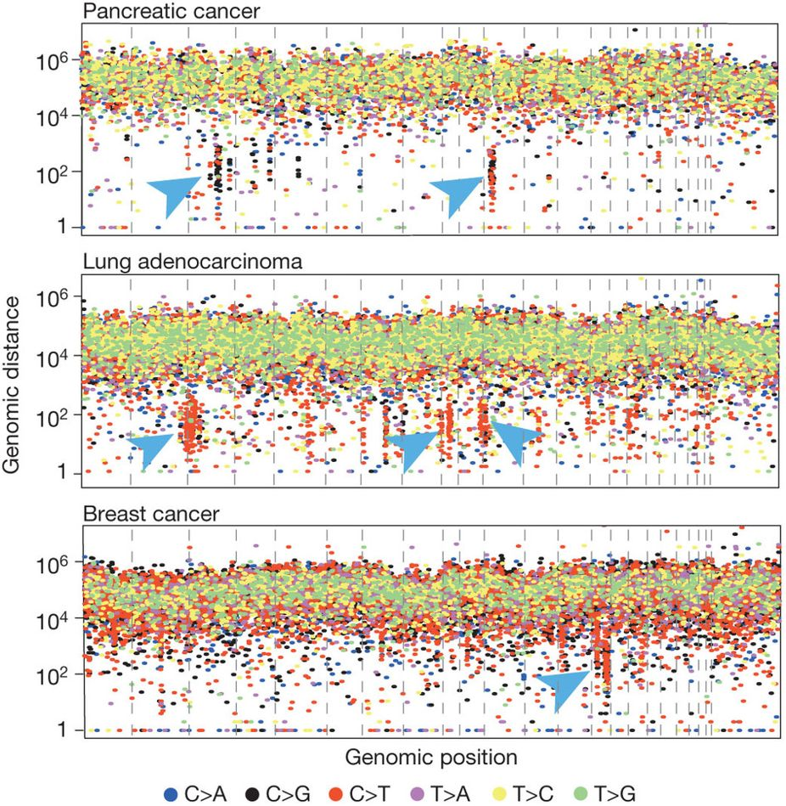
Figure 6 : Kataegis in three cancers.
Each of these ‘rainfall’ plots represents an individual cancer sample in which each dot represents a single somatic mutation ordered on the horizontal axis according to its position in the human genome. The vertical axis denotes the genomic distance of each mutation from the previous mutation. Arrowheads indicate clusters of mutations in kataegis.
Notes:
Each of these ‘rainfall’ plots represents an individual cancer sample in which each dot represents a single somatic mutation ordered on the horizontal axis according to its position in the human genome. The vertical axis denotes the genomic distance of each mutation from the previous mutation. Arrowheads indicate clusters of mutations in kataegis.

